Slide 1


DATA221 Intro Machine Learning 12
William Trimble

Slide 2
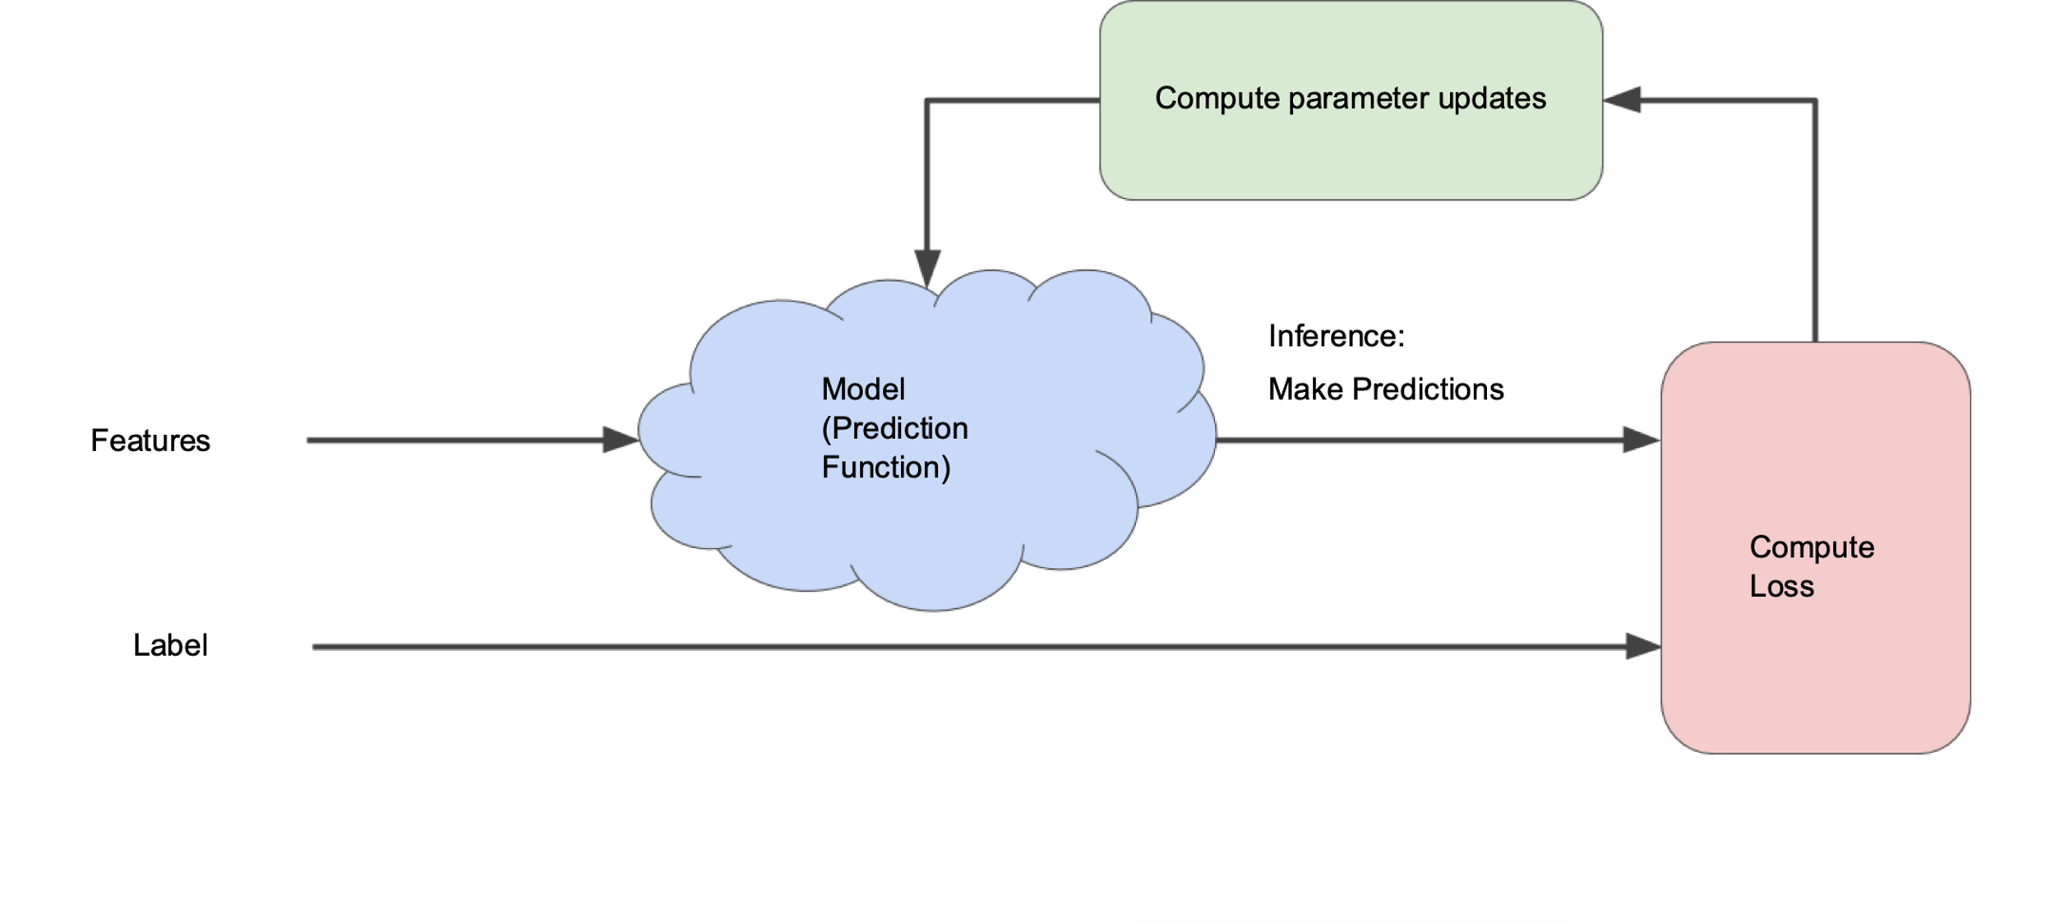
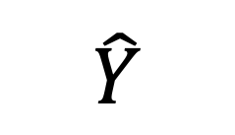
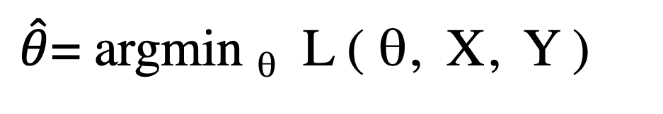
The optimization paradigm
$\hat{θ}$= argmin _{θ} L ( θ, X, Y )
θ
$$\hat{Y}$$
X
Loss
Y

Slide 3
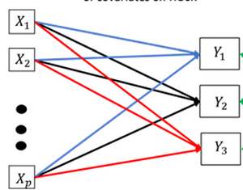
Q
x₁
x₄
x₂
x₃
w₁
w₂
w₃
w₄
Beak length,
mass
Species
inference
n
x₁
x₄
Q
e₁^{T}
y
x₂
x₃
w₁
=
w₂
n
w₃
w₄
(n x p)
(n x r)
(r x p)
X_{r}

Slide 4
Q
x₁
x₄
x₂
x₃
w₁
w₂
w₃
w₄
Features
Class
inference
p classes
r features
p classes
n
x₁
x₄
Q
e₁^{T}
y
x₂
x₃
w₁
=
w₂
n
n samples
w₃
w₄
(n x p)
(n x r)
(r x p)
X_{r}

Slide 5
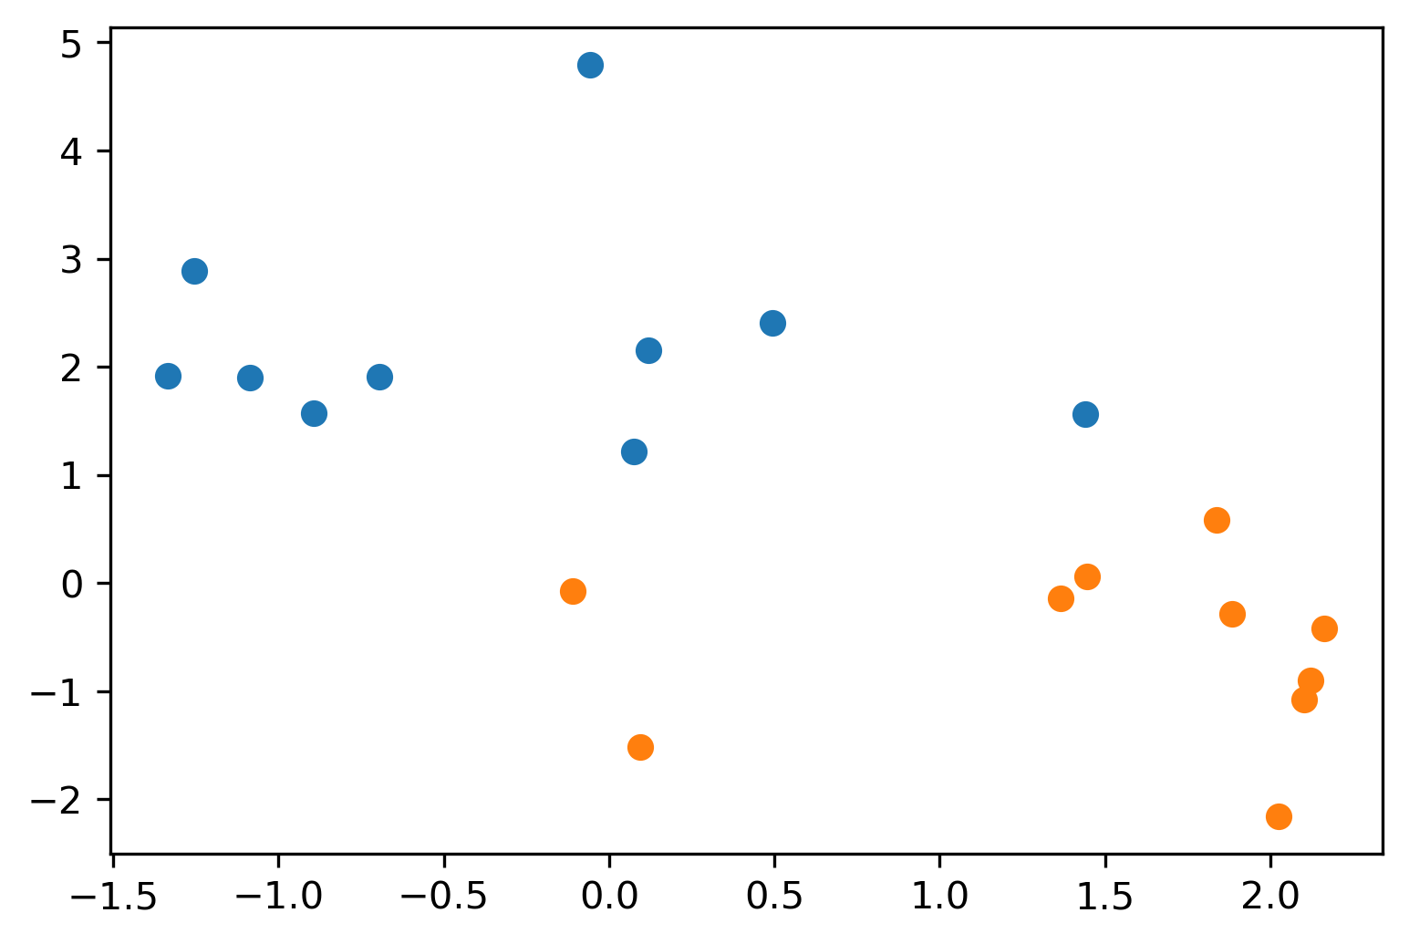
Maximum-margin line of thinking…
There will be a minimum value of the margin that “works” – minimum linear-classification error on the training data

Slide 7
Larger values of the margin will include more points.
Number of points… function of margin parameter

Slide 8
Math elided
The optimization that produces the soft-margin maximum-discrimination line (hyperplane) depends on the training points: features and class identity
Usually doesn’t depend on all of them
Number of points considered depends on margin parameter
Depends on training data only through the values of x_{i} dot x_{j} !!!! (There are n² / 2 of these !!)

Slide 9
Support Vector Machine
The (limited) set of training points whose geometry is used to find the boundary are called “support vectors;” they support the inference of the position of the boundary.
The rule to combine training examples to construct the boundary can be more elaborate than a separating hyperplane; the function that weights the training data is called the “kernel”
This technique can be adapted to implement fits like logistic regression and fits like KNN classifier.

Slide 10
Inner products all-against-all columns
n
r
r
A^{T}
A
A^{T}A
=
r
r
n
The linear algebra product A^{T}A computes all-against-all IPs
This matrix has dimensions r_features x r_features.
Values (A^{T}A)_{ij} are inner products of column i and column j

Slide 11
Inner products all-against-all rows
m
n
n
A
A^{T}
AA^{T}
=
m
n
n
This matrix has dimensions n_samples x n_samples.
Values (AA^{T})_{ij} are inner products of row i and row j

Slide 12
Parameters
Observations
N(Data) > N(Parameters)
Overdetermined
Underparameterized
Normal ”fitting”,
least-squares
or not, is like this.
ℝ ^{r}
ℝ ^{r}
ℝ ^{n}
N(Parameters0) > N(Data)
Underdetermined
Overparameterized
ℝ ^{r}
ℝ ^{n}
ℝ ^{r}

Slide 13
Parameters
Observations
N(Data) > N(Parameters)
Overdetermined
Underparameterized
Normal ”fitting”,
least-squares
or not, is like this.
ℝ ^{r}
ℝ ^{r}
ℝ ^{n}
N(Parameters0) > N(Data)
Underdetermined
Overparameterized
Iterating over n
is easier than iterating over r
ℝ ^{n}
ℝ ^{r}
ℝ ^{n}
ℝ ^{r}
Many dimensions must
be filled with information from prior / regularization

